Slide 1
Control unit
Unit 5

Slide 2
What is a Control Unit?
The Control Unit is the part of the computer’s central processing unit (CPU), which directs the operation of the processor.
It was included as part of the Von Neumann Architecture by John von Neumann.
It is the responsibility of the control unit to tell the computer’s memory, Arithmetic/logic unit, and input and output devices how to respond to the instructions that have been sent to the processor.
It fetches internal instructions of the programs from the main memory to the processor instruction register, and based on this register contents, the control unit generates a control signal that supervises the execution of these instructions.

Slide 3
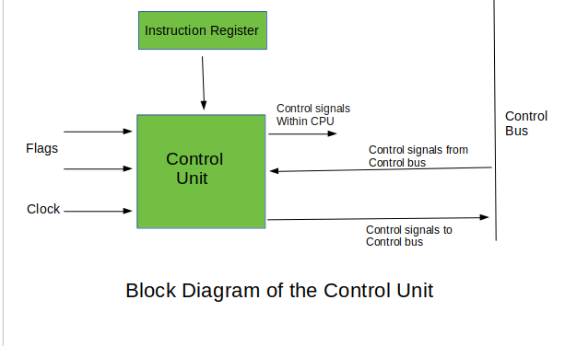
A control unit works by receiving input information which it converts into control signals, which are then sent to the central processor.
The computer’s processor then tells the attached hardware what operations to perform.
The functions that a control unit performs are dependent on the type of CPU because the architecture of the CPU varies from manufacturer to manufacturer.
Examples of devices that require a CU are:
Control Processing Units(CPUs)
Graphics Processing Units(GPUs)

Slide 4
Functions of the Control Unit
It coordinates the sequence of data movements into, out of, and between a processor’s many sub-units.
It interprets instructions.
It controls data flow inside the processor.
It receives external instructions or commands to which it converts to sequence of control signals.
It controls many execution units(i.e. ALU, data buffers and registers) contained within a CPU.
It also handles multiple tasks, such as fetching, decoding, execution handling and storing results.

Slide 5
The Control Unit has a significant role within a computer system, which includes:
Fetching instructions from memory
Decoding instructions to determine what operation to perform
Controlling and coordinating the execution of instructions
Managing data flow between various units of the computer
Monitoring and regulating the synchronization of input and output devices

Slide 6
Control Unit Function: Managing Data Flow
The Control Unit is responsible for managing data flow and the execution of instructions within the computer system.
To do this, it performs a series of steps known as the fetch-decode-execute cycle. These steps include:
Fetching: The Control Unit retrieves the next instruction from memory.
Decoding: The fetched instruction is analyzed to determine the operation to be performed and the operands involved.
Executing: The Control Unit sends control signals to the appropriate parts of the computer to perform the instruction.
Storing: Upon completion of the instruction, any resulting data is stored in the desired location.

Slide 7
For example,
if a computer is instructed to perform a simple addition operation, the Control Unit would fetch the instruction, decode it to understand that it's an addition operation, and then send signals to the ALU to perform the calculation.
After the ALU completes the addition, the Control Unit stores the result in a specified memory location.

Slide 8
Exploring Types of Control Units
Each type bears its own set of advantages and disadvantages, catering to different situations depending on their respective characteristics and performance attributes.
There are two types of control units:
Hardwired control unit .
Micro programmable control unit.

Slide 9
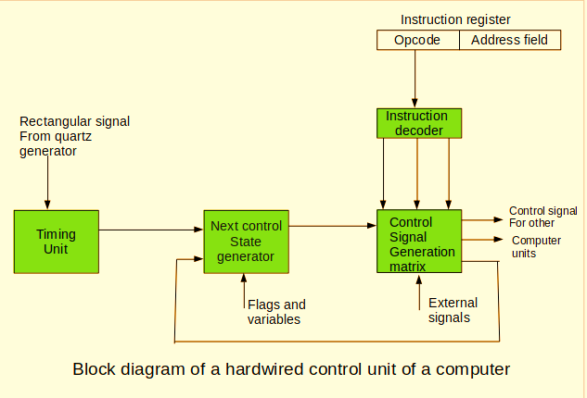
Hardwired Control Unit
A Hardwired Control Unit is a type of Control Unit that relies on circuits and fixed wiring to generate control signals.
It uses combinational logic circuits, designed through a process called "circuit synthesis" which involves optimization techniques to create a circuit specifically for a given function.

Slide 10
The advantages of a Hardwired Control Unit include:
Speed: As the control signals are generated by fixed wired connections, the processing speed is generally faster than its Microprogrammed counterpart.
Efficiency: Due to the purpose-built nature of the circuit, the Hardwired Control Unit typically exhibits a high level of efficiency, as it relies on optimized connections designed exclusively for its intended use.
Reliability: A Hardwired Control Unit tends to be more reliable, as the complexity of the microcode is eliminated, reducing the risk of errors in the system.

Slide 11
Despite its advantages, the Hardwired Control Unit also presents certain drawbacks:
Flexibility: Hardwired Control Units lack flexibility as changes in the design require physical modifications in the wiring, making it difficult to adapt to new tasks, requirements or updates.
Complexity: The design process for a Hardwired Control Unit is complicated due to the need for intricate optimization techniques and the usage of complex circuitry, which in turn increases the design and manufacturing costs.
Scalability: Upgrading a Hardwired Control Unit is challenging, as it involves redesigning and manufacturing a new circuit to accommodate the required changes.

Slide 12
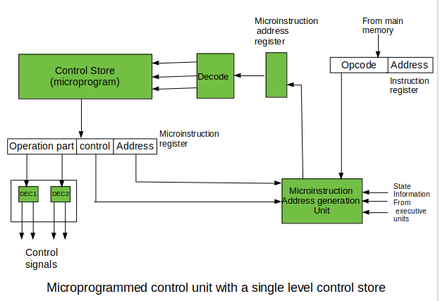
Microprogrammed Control Unit: Flexibility and Adaptability
A Microprogrammed Control Unit, on the other hand, relies on microcode and easily modifiable firmware to generate control signals.
In this structure, control information is stored in a microcode memory, and the microprocessor fetches instructions from this memory to produce control signals.

Slide 13
The benefits of using a Microprogrammed Control Unit include:
Flexibility: Microprogrammed Control Units have higher flexibility, as alterations and updates in the microcode allow changes to be made without the need for physical modifications to the circuitry.
Adaptability: A Microprogrammed Control Unit can support different instructions sets and architectures with relative ease, provided that the microcode is updated accordingly.
Simplicity: The design, implementation and maintenance of a Microprogrammed Control Unit are comparatively simpler than those of a Hardwired Control Unit, making it easier to manage and optimize.
Scalability: Upgrading or expanding the capabilities of a Microprogrammed Control Unit is less challenging, since it can be achieved with microcode updates, eliminating the need for extensive physical redesigns.

Slide 14
Types of micro-instruction formats:
There are three types of microinstruction formats
Horizontal Format, called Horizontal microcode
Vertical Format, called Vertical microcode
Each of these formats provides a trade off in terms of the control store size and the speed of operation of the control unit.

Slide 15
1. Horizontal Microcode:
In the horizontal format, each control signal is represented by a single bit in the control word.
Thus, if the design has 500 control signals, this will require 500 bits in each control word to store the control bits.
In this format, the control store looks horizontal in shape since the control words are wide.
The disadvantage of the horizontal format is that the size of the control store is large.
However, it has the advantage of speed of operation as the control signals will be ready as soon as the control word is fetched from the control store.

Slide 16
:
2.Vertical Microcode:
Identify the number of distinct control words in the design Encode each distinct control word by assigning a unique n-bit code to it, where n is log2 (number of distinct control words).
Instead of storing the actual control signals that need to be generated, only the n-bit code is stored for each CW Use a nx2n decoder to generate a decoded signal for each distinct control word
To generate the control signals, use an OR gate based on the decoded control word signals, for each control signal in the design.
The following figure illustrates the horizontal and vertical control store organization.
To illustrate the vertical microcode organization, suppose that we have only the instruction ADD R1, [R3] (R1← R1 + [R3]).
The control words for this instruction and the code assigned to each control word is shown below:

Slide 17
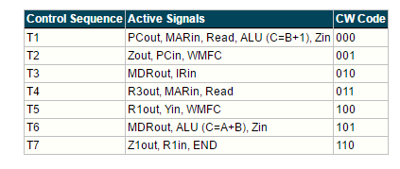

Slide 18
Since we have 7 distinct CWs, we need to encode each control word using a 3-bit code. We also need a 3x8 decoder to decode the CW codes and generate the decoded CW signals.
The following figure illustrates the generation of some of the control signals in this example.
The vertical microcode organization reduces the width of the CWs making the control store having the vertical shape.
The advantage of the vertical microcode organization is that it reduces the control store size significantly.
For example, suppose that a design has 500 control signals and 100 CWs. The size of the control store will be 100x(7+500+7) = 51400 bits. Note that the first 7 bits are used for Mux control and uBranch control signals.
The last 7 bits are for storing the uBranch address. However, in the vertical microcode organization each CW will be encoded with 7 bits since we have 100 CWs. So, the size of the control store will be 100x(7+7+7)= 2100 bits.
The vertical microcode organization provides slower implementation compared to the horizontal microcode organization.
To generate the control signals, it requires reading the CW code from the control store, decoding the CW, and then using OR gates. This requires more time and slows down the control unit operation.

Slide 19
Microoperation, Microinstruction, Micro program, Microcode.
Microoperations:
In computer central processing units, micro-operations (also known as a micro-ops or μops) are detailed low-level instructions used in some designs to implement complex machine instructions (sometimes termed macro-instructions in this context).
Micro instruction:
A symbolic microprogram can be translated into its binary equivalent by means of an assembler.
Each line of the assembly language microprogram defines a symbolic microinstruction.
Each symbolic microinstruction is divided into five fields: label, microoperations, CD,BR, and AD.

Slide 20
Micro program:
A sequence of microinstructions constitutes a microprogram.
Since alterations of the microprogram are not needed once the control unit is in operation, the control memory can be a read-only memory (ROM).
ROM words are made permanent during the hardware production of the unit.
The use of a micro program involves placing all control variables in words of ROM for use by the control unit through successive read operations.
The content of the word in ROM at a given address specifies a microinstruction

Slide 21
Microcode:
Microinstructions can be saved by employing subroutines that use common sections of microcode.
For example, the sequence of micro operations needed to generate the effective address of the operand for an instruction is common to all memory reference instructions.
This sequence could be a subroutine that is called from within many other routines to execute the effective address computation.

